Slide 1






CONTOSO CO.
JULY 31, 2024
GROUP 4
INFS5700 Introduction to Business Analytics
Sandbox Industry Project
Lu Yan
Yimin Cheng
Ruby Zeng
Yiyang Liu
Natalie Lai
Vaishnav Gadia
Notes:
Hello, everyone. Thanks for your time tonight. We are group 4. We are going to give you some insights and recommendations for office furniture manufacturing industry in US. This is our team member......

Slide 2
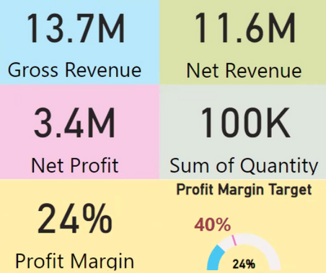
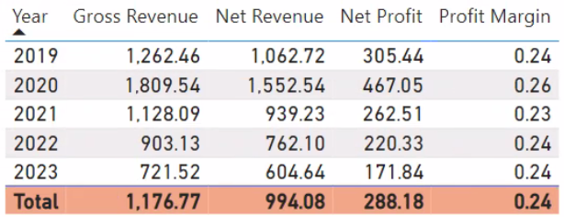

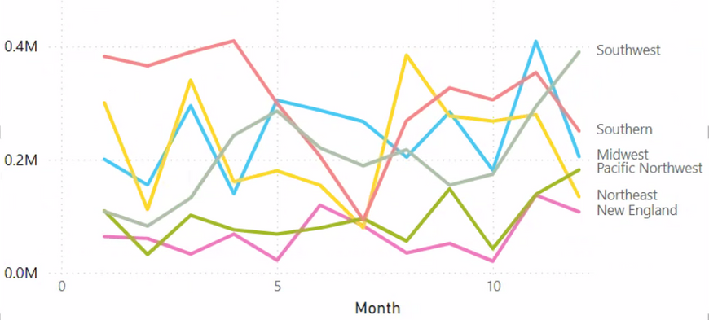


Sales - Overview
Overall
Average
The company performed well in terms of revenue and net profit, showing a certain market competitiveness and profitability.
The profit margin of 24% is also a relatively healthy level.
Gross revenue peaked in 2020.
Net revenue has declined in line with gross revenue.
Net profit peaked in 2020 and then declined year after year, with a significant decline in 2023.
Relatively stable profit margin.
Highest: August November
Lowest: June, September
Volatile: Southwest, Pacific Northwest
Relatively stable: Midwest, New England
Gross Revenue Trend by Month and Region
Insights
Seasonal Variation
End-of-year purchases: Many companies focus on purchasing office facilities at the end of the fiscal year to meet their annual budget.
Shopping during and around holidays.
Economic and Market environment
Economic conditions: During periods of economic uncertainty or recession, businesses may reduce purchases.
Market demand: The popularity of telecommuting.
Sales
Products
Customers
Final Recommentation
Notes:
In overall sales chart:
The company performed well in terms of revenue and net profit, showing a certain market competitiveness and profitability.
The profit margin of 24% is also a relatively healthy level.
Average sales chart:
Gross revenue peaked in 2020.
Net revenue has declined in line with gross revenue.
Net profit peaked in 2020 and then declined year after year, with a significant decline in 2023.
Relatively stable profit margin.
Insights:
Highest: Month 8
Lowest: Month 6, Month 9
Volatile: Southwest, Pacific Northwest
Relatively stable: Midwest, New England
Factors:
Seasonal Variation
End-of-year purchases: Many companies focus on purchasing office facilities at the end of the fiscal year in order to meet their annual budget.
Shopping during and around holidays.
Economic and Market environment
Economic conditions: During periods of economic uncertainty or recession, businesses may reduce purchases.
Market demand: The popularity of telecommuting.

Slide 3
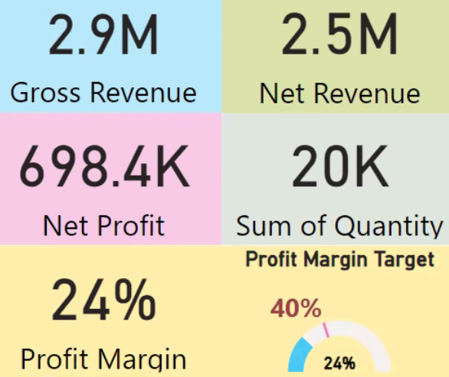
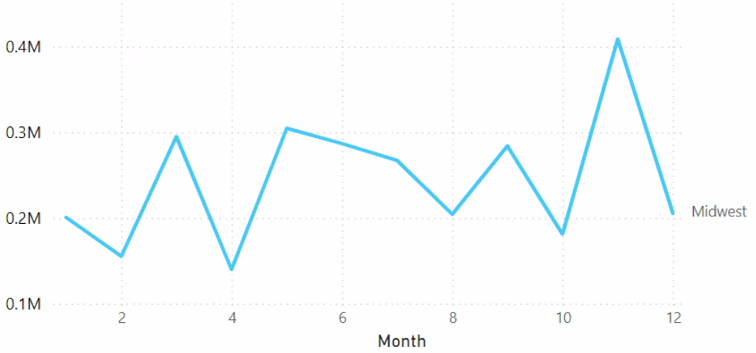
Sales - Midwest Overview
Year 2019 - 2023
Year 2019 - 2023 Gross Revenue Trend by Month and Region
Insights
There is a significant drop in gross to net revenue, may be due to high returns, discounts, or perks.
Compare the overall sales, with profit margins of 24%, Midwest relatively stable, but both profit margins fell short of the target.
Growth and low periods: There are obvious sales peaks and troughs every year, may be due to seasonal factors, market activities, promotional strategies, etc.
Peak of the year: November is often the peak of sales, may be related to increased demand for purchases at the end of the year, promotional activities, and preparation before the holidays.
Low point of the year: April is often the lowest point for sales, possibly due to weak demand at the end of the first quarter or the absence of special promotions.
Sales
Products
Customers
Final Recommentation
Notes:
In this slide, based on the overall sales trend, we analyse the Midwest’s sales performance.
Look at the Midwest’s sales for 2019-2023, there is a significant drop in gross to net revenue, may be due to high returns, discounts, or perks.
Compare the overall sales, with profit margins of 24%, Midwest relatively stable, but both profit margins fell short of the target.
We also observe the “year 2019-2023 gross revenue trend by month and region”. In this chart, there are obvious sales peaks and troughs every year, we think these fluctuations may be related to seasonal factors, market activities, promotional strategies.
November is often the peak of sales, which may be related to increased demand for purchases at the end of the year, promotional activities, and preparation before the holidays.
April is often the lowest point for sales, possibly due to weak demand at the end of the first quarter or the absence of special promotions.

Slide 4
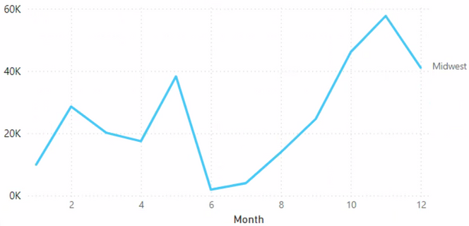
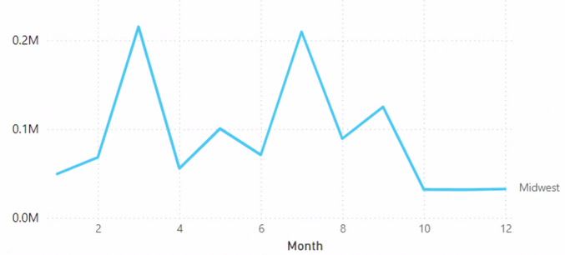
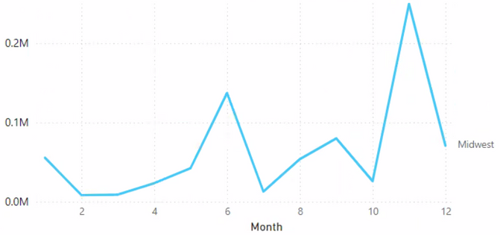
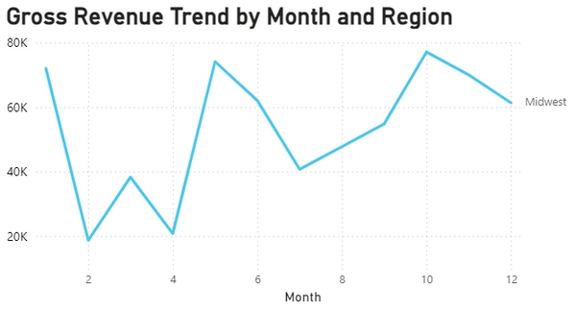
Sales - Gross Revenue Trend by Month and Region (Midwest Every Year)
Year 2019
Year 2020
Insights
January to June: Sales are sometimes stable and sometimes volatile.
July to September: Sales are basically growing.
October to December: Sales generally pick up and peak at the end of the year.
Year 2021
Year 2022
Recommendation:
Multi-channel Sales Strategy: Online sales channels, such as e-commerce platforms and self-owned websites.
Optimize Supply Chain Management: Use data analysis to optimize inventory management and reduce inventory costs.
Seasonal Sales Planning: Plan production and inventory management in advance according to seasonal trends.
Target review: Re-evaluate the 40% margin target to ensure it is given market conditions and business model constraints.
Sales
Products
Customers
Final Recommentation
Notes:
Also, look at every year, it's pretty much the same overall sales trend of Midwest. January to June, sales are sometimes stable and sometimes volatile. July to September, sales are basically growing. October to December, sales generally pick up and peak at the end of the year.
In view of the sales analysis, we have three recommendations for the company to develop.
First is multi-channel sales strategy, company could develop the online sales channels such as e-commerce platforms and self-owned websites.
Second is optimize supply chain management, company could use data analysis to optimize inventory management and reduce inventory costs.
Third is seasonal sales planning, company can plan production and inventory management in advance according to seasonal trends.
Fourth is target review, company can re-evaluate the 40% margin target to ensure it is given market conditions and business model constraints.

Slide 5
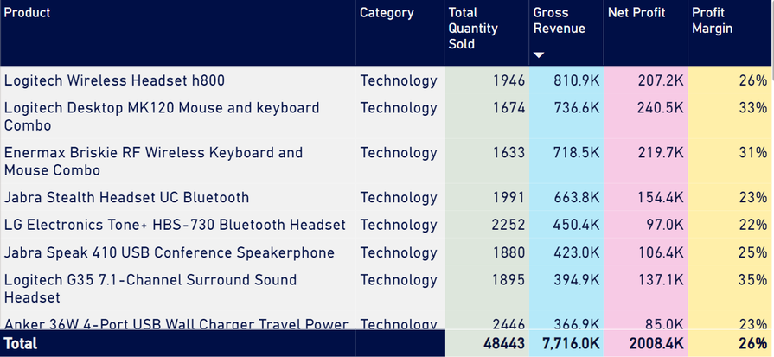
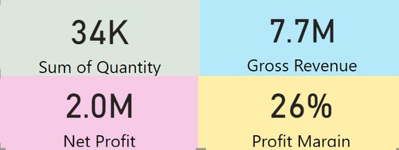
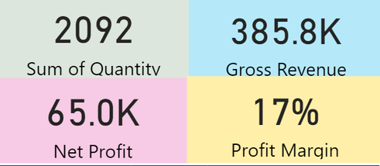
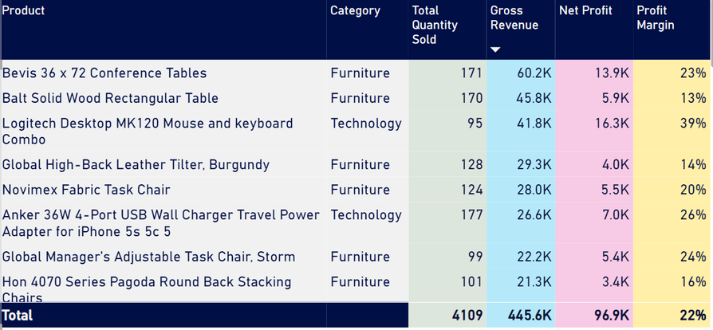
Products - The Most Popular Products
The most popular products in 2019 - 2024 in most region
2019 - 2022 most popular products categories - Technology data
2023 most popular products categories - furniture data
Insights
Before 2022, the demand for computer-related products increased, as people were forced to work and play at home due to the impact of the pandemic.
In 2023, society has led to a growing demand for Durable furniture significantly. but the low profit margin indicates that the overall consumption of the society may have declined.
Product trends in different years may be related to the economic cycle. In times of weak economy, more affordable and durable products may be more popular.
The most popular products in 2023 in most region
Recommendation:
Focusing on cost-effective good brand products can bring continuous and large orders and good profit margins.
After 2023, we should provide more options of durable furniture for society.
Overall consumption level of the society is reducing. We could design more specific promotional activities for different regions.
Pay more attention to market changes, such as remote working trends or technological advances, that may affect the type of the most popular products we sold.
Sales
Products
Customers
Final Recommentation
Notes:
As you see, the most popular products based on gross revenue before 2022 are most technology products.
In particular, the Enermax Briskie RF wireless keyboard and mouse combination
Logitech desktop MK120 mouse and keyboard combination
Logitech wireless headset h800
We can see that these three all are computer-related products. These three products are the best-selling products in most regions from 2019 to 2022. They are cost-effective products from nice brand.
When 2023, the most popular products in most regions are mostly tables and chairs. But the profit margins of these products are lower than before.
Insight
1. Before 2022, the demand for computer-related products increased, as people were forced to work and play at home due to the impact of the pandemic.
2.In 2023, society has led to a growing demand for Durable furniture significantly. but the low profit margin indicates that the overall consumption of the society may have declined.
3. Product trends in different years may be related to the economic cycle. In times of weak economy, more affordable and durable products may be more popular.
Recommandation:
1. Focusing on cost-effective good brand products can bring continuous and large orders and good profit margins.
2. After 2023, we should provide more options of durable furniture for society.
3. Overall consumption level of the society is reducing. We could design more specific promotional activities for different regions.
For example, offer more discounts to the areas with slightly weaker economies.
4. Pay more attention to market changes, such as remote working trends or technological advances, that may affect the type of the most popular products we sold.

Slide 6
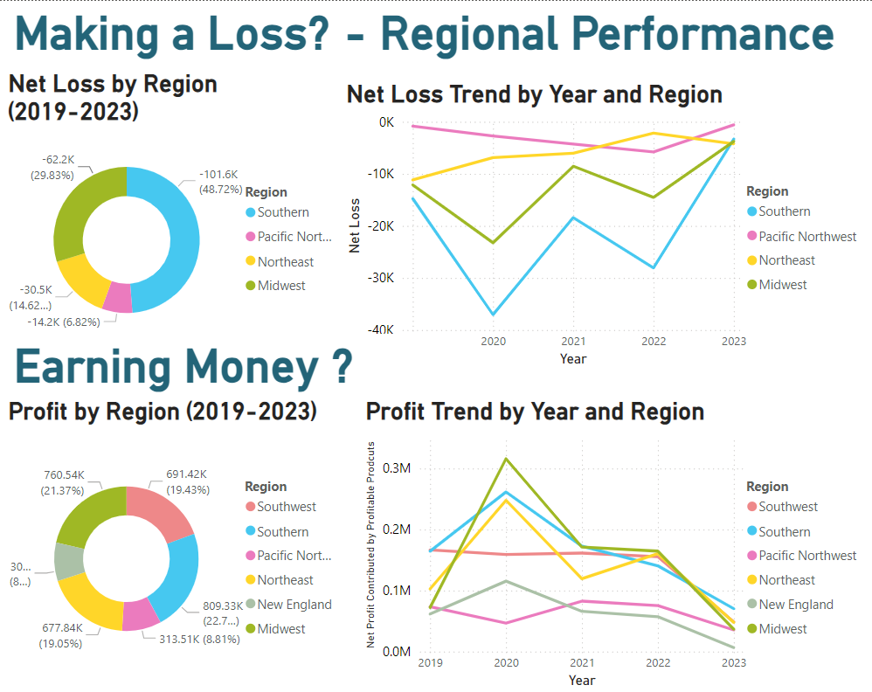
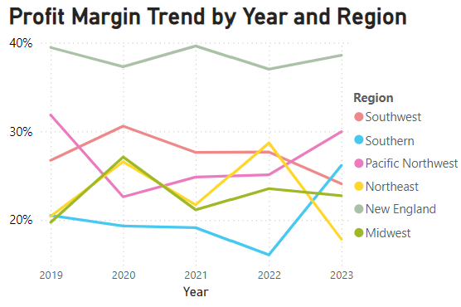
Insights
No Losses: Southeast & New England never made a loss (2019-2023).
High Losses: Southern region has the highest loss, followed by the Midwest.
High Profit: Midwest & Southern.
High Profit Margin: New England has the highest profit margin (~40%).
Next Steps: Focus on Southern for loss analysis and Southeast for profitability analysis.
Sales
Products
Customers
Final Recommentation
Notes:
In this slide, we divide the net profit margin into loss-making and profit-making to analyse regional performance.
Southeast and New England never made a loss from 2019 to 2023.
The Southern region consistently shows the highest loss, followed by the Midwest.
However, they also generate the highest profit.
New England has the highest profit margin, almost reaching our 40% target, despite being a low-sales region, followed by southeast.
We'll focus on the Southern region for loss analysis and the Southeast for profitability analysis.

Slide 7
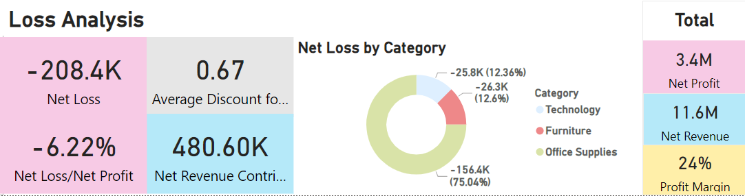
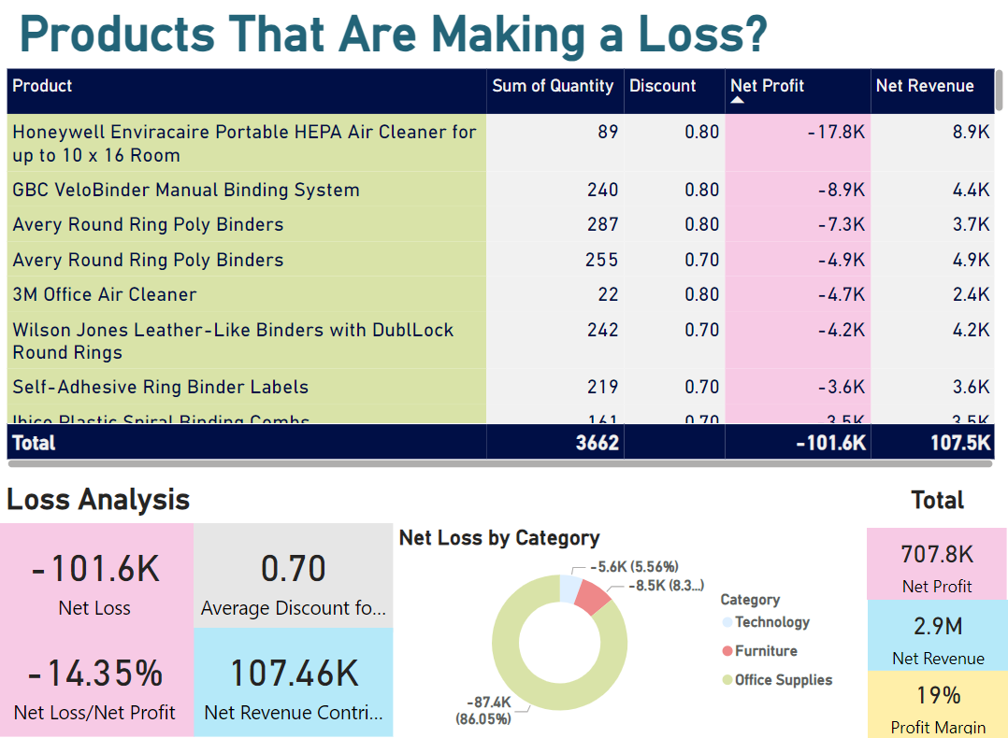
Loss Analysis - Overall
Products That Made a Loss in the Southern
What’s going on in the Southern?
Southern Region Loss:
Loss making proportion in the Southern region is 14%, more than double the overall of 6.22%.
High Discounts in Southern Region:
Average discount for loss-making products in the Southern region is 70%, indicating significant markdowns compared to the overall average.
Office Supplies Impact:
In the Southern region, office supplies contribute to 86% of the loss, compared to 75% overall.
Specific Items in Southern Region:
Losses in the Southern region include expiring air cleaners and overstocked homogenous binders, highlighting inventory management issues.
Sales
Products
Customers
Final Recommentation
Notes:
Overall, the net loss divided by net profit is 6.22%.
In the Southern region, the net loss proportion is around 14%, more than double the overall percentage. The average discount for loss-making products is 70%, indicating heavy discounting.
Office supplies make up 86% of the loss, including near-expiry air cleaners and overstocked binders.

Slide 8
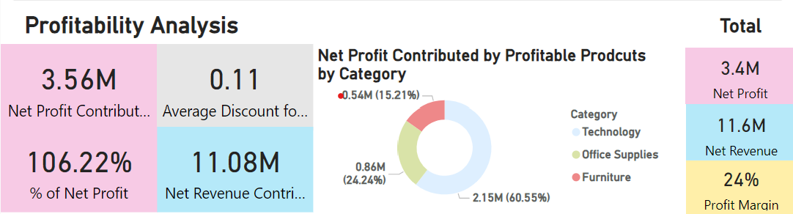
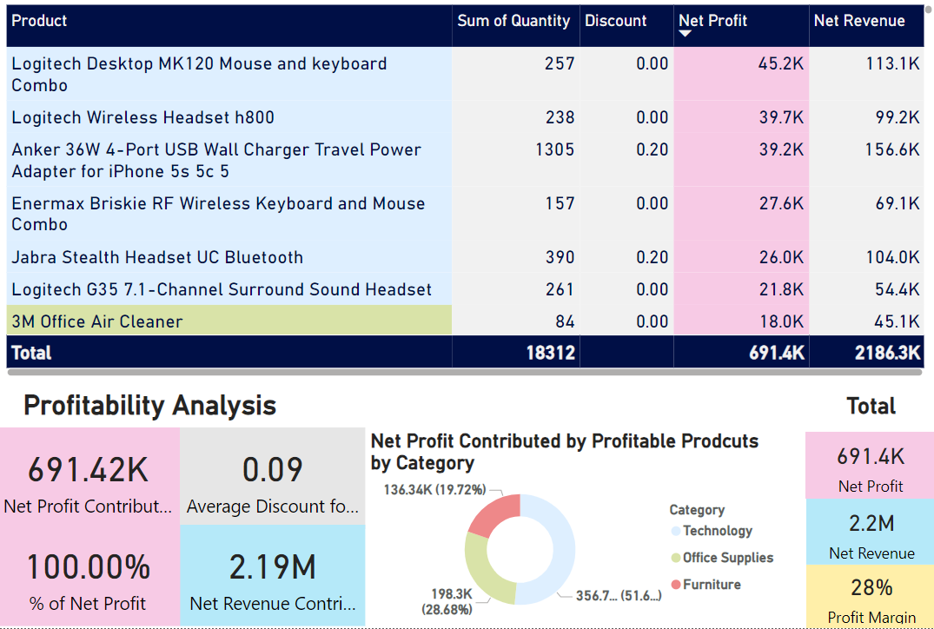
Profitability Analysis - Overall
What’s going on in the Southeast?
Southeast Profitability:
No losses; all products made profits.
Average product discount is 9%.
Technology products contribute around 50% of profits, followed by office supplies.
Notable Product:
3M Air cleaner is highly profitable with no discounts.
Limitations:
Analysis excludes factors like warehouse location, regional demographics, and industrial characteristics.
Recommendations:
Improve inventory management to avoid overstocking and handle expiring products efficiently.
Implement reasonable discount strategies to prevent large losses.
Develop sales promotions to boost revenue in profitable areas while increasing profit margins.
Products That Are Profitable in Southeast
Sales
Products
Customers
Final Recommentation
Notes:
The Southeast region has not suffered any losses from 2019 to 2023, meaning all its products made profits.
The average discount is around 9%, indicating minimal promotions. Technology products contribute to around half of the profit. Notably, air cleaners are profitable here.
However, Limitations of this analysis include ignoring factors like warehouse location and regional demographics.
Recommendations:
To improve overall performance, I have a few recommendations:
1. Improve inventory management to avoid near-expiry and overstocked products.
2. Set reasonable discounts to prevent significant losses.
3. Increase sales promotions in profitable regions to boost revenue without sacrificing profit margins, aiming to meet the 40% target.

Slide 9
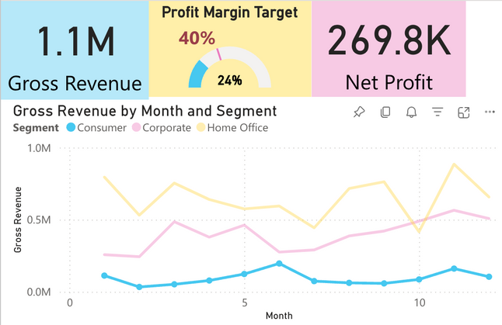
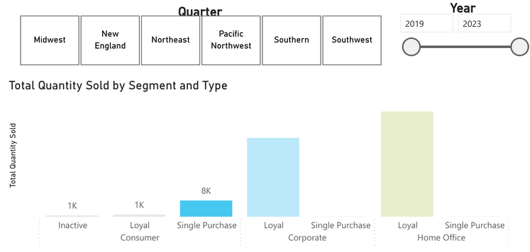
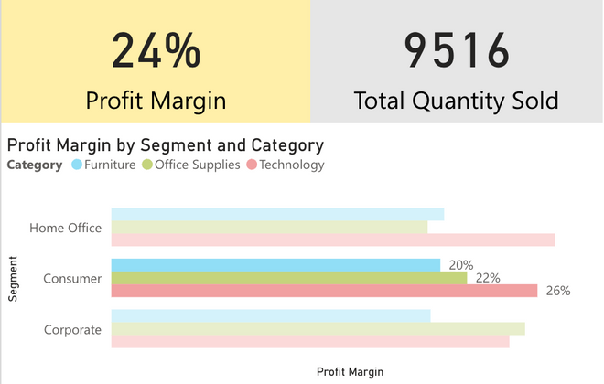
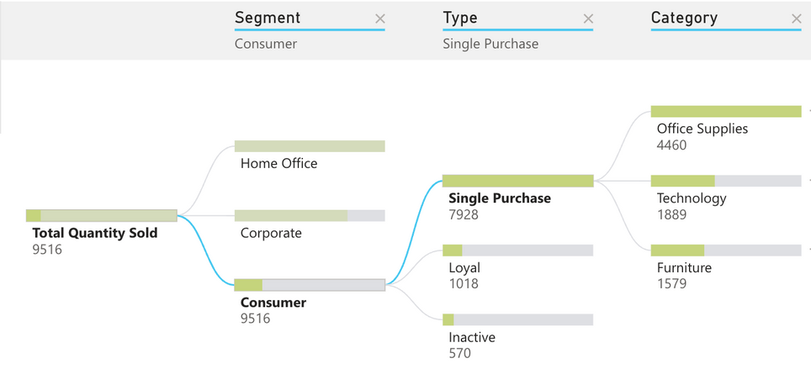
Customer Segment - Consumers
Insights
Overall 1.1 million revenue, profit margin at 24%.
Most quantity sold was single purchase items at 8k.
Most products sold are office supplies at 4.5k , with a profit margin of only 22%.
Quite low compared to technology that sold less at 1.8 thousand, but has a higher profit margin at 26%.
Furniture sold the least at 1.5 thousand, profit margin is lowest at 20%.
Recommendation:
Consumers: Focus on selling more technology to drive revenue up.
Bulk buy Incentives or bundle packages at discounted rates.
Loyalty program – buyers can collect points for each purchase, and points can be used as discounts for future tech purchases.
Support packages – can offer extended warranties, technology support packages to add value to their purchases.
Sales
Products
Customers
Final Recommentation
Notes:
Thank you Ruby. Moving on, I will cover the Customer Segment section and focus on Consumer and Home Segments today.
For Consumers:
• We can see it sold the lowest amount overall at 1.1 million revenue, profit margin at 24% compared to benchmark of 40%.
• Most quantity sold was in the single purchase items at 7.9 thousand.
• Upon analysis of the single purchase items, I notice that most products sold is office supplies at 4.5 thousand, with profit margin at only 22%.
• This is quite low compared to technology that sold less at 1.8 thousand, but has a higher profit margin at 26%.
RECC: Consumers: Focus on selling more technology to drive revenue up.
We can achieve this by:
o Introducing bulk buy incentives or bundle packages at discounted rates
o Introduce loyalty program – where buyers can collect points for each purchase, and these points can be used as discounts for future tech purchases
o Consider Support packages – can offer extended warranties, tech support packages to add value to their purchases

Slide 10
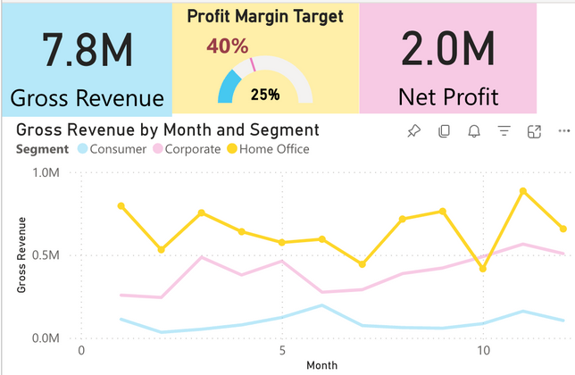
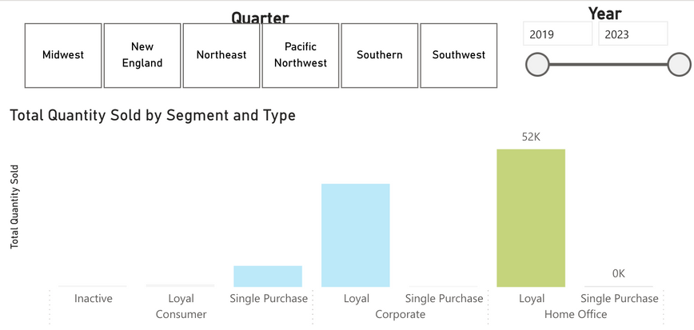
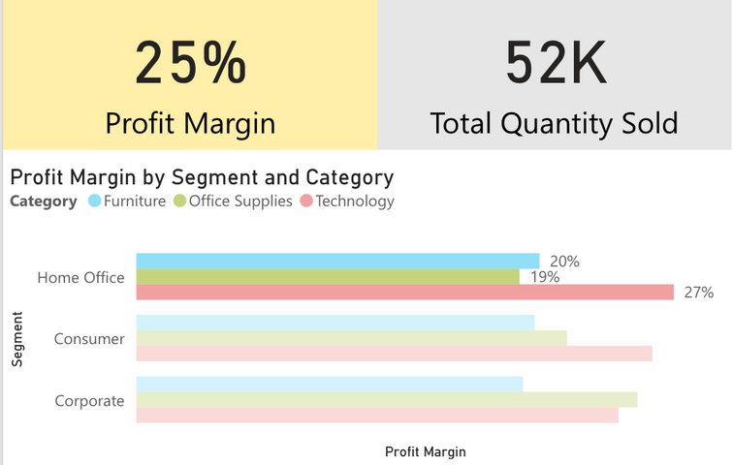
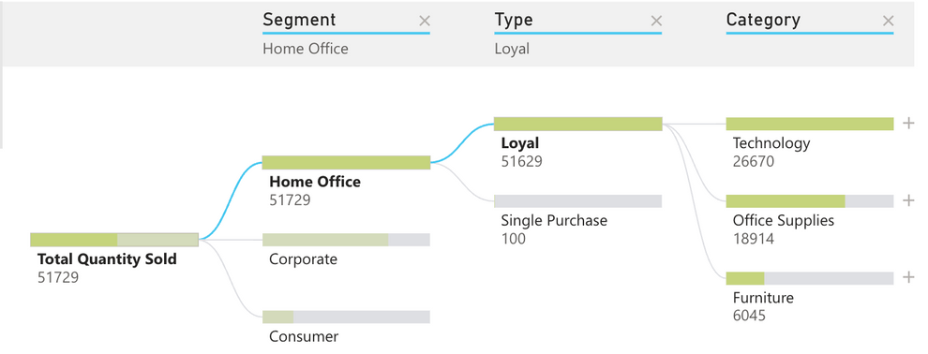
Customer Segment - Home Office
Insights
Most profitable grossing 7.8 million, profit margin at 25%.
Just like Corporates, only loyal repeating customers contributed to sales, selling roughly 52 thousand products.
We can see these loyal customers bought the highest amount of technology at 27 thousand. I also noticed this aligns to their profit margin at 27%.
Office supply sold 18 thousand, their profit margin was only 19%.
Furniture quantity was lowest at 6 thousand, but interesting fact was they had a higher profit margin at 20% compared to office supplies.
Recommendation:
Home Office: Strategize efforts to sell more furniture to boost revenue.
Customisation of products – enable buyers to customise furniture to meet their home office preferences.
Example - modular designs offering interchangeable parts, a variety of fabric/material options, and made-to-measure option.
Instalment plans – to offer flexible payment plans for easier investment in higher-priced furniture.
Sales
Products
Customers
Final Recommentation
Notes:
Next is Home office segment:
• Was most profitable grossing 7.8 million in revenue, profit margin at 25% compared to benchmark of 40%.
• Here, I gathered that only loyal repeating customers contributed to sales, selling roughly 52 thousand products.
• On close inspection of those 52k products, we can see these loyal customers bought the highest amount of technology at 27 thousand. I also noticed this aligns to their profit margin at 27%.
• This makes sense that tech quantity is highest due to current hybrid work environment, so more people are choosing to work from home and thus needing to buy more tech products to accommodate this.
• Next is Office Supply selling 18 thousand products, their profit margin was only 19%.
• Finally, we can see that furniture quantity was lowest at 6 thousand, but interestingly, they had a higher profit margin than office supplies at 20%.
My recommendation here is:
Strategize to focus efforts on selling more furniture to boost revenue
o Customisation of products – enable buyers to customise furniture to meet their home office preferences
o Installment plans – to offer flexible payment plans for easier investment in higher priced furniture
I will pass onto Viashnav for the next part.

Slide 11
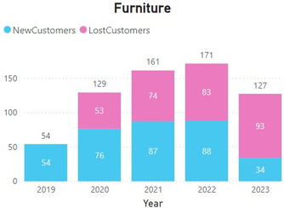
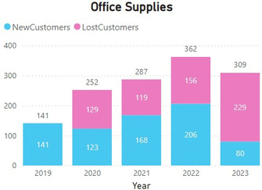
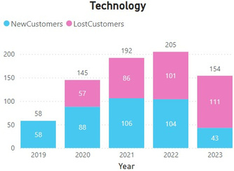
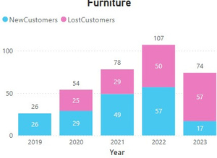
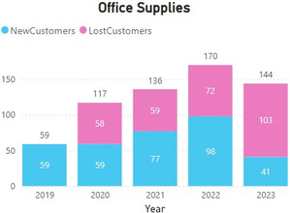
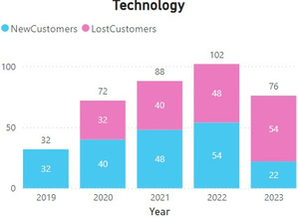
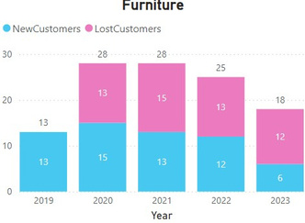
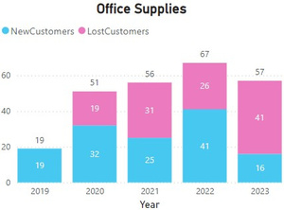
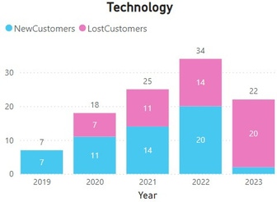
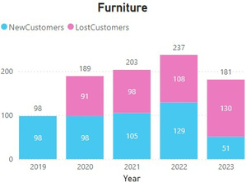
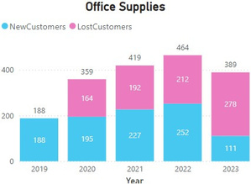
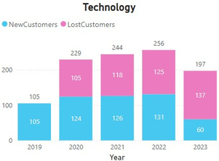
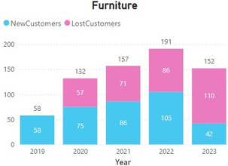
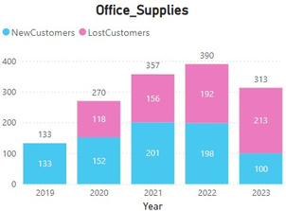
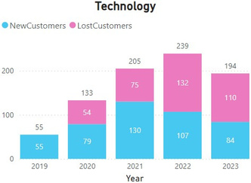
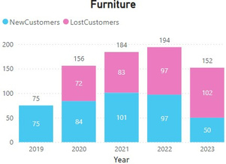
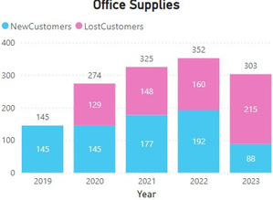
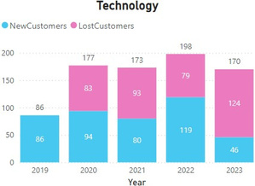
Customer Segment - New/Lost Customers
Midwest
Pacific North West
New England
Southern
Northeast
Southwest
Recommendations
Insights
Increase Consumer Base: Propose strategies to diversify the consumer base across demographics.
Customized Loyalty Programs: Deploy AI-powered reward programs according to metrics (like age, region, category, order frequency) and analyze the real time data insights.
Feedback: Promote businesses and consumers to participate in surveys to improve the products and services offerings.
In Furnitures category, Southern region, in Office Supplies category, Midwest and southwest region and in Technology category, New England region.
Technology category is the most volatile over the years across all regions.
2023 saw the most decline in repeat customers across all categories.
During pandemic, the most affected category is Office Supplies and Technology.
being the least affected category.
Sales
Products
Customers
Final Recommentation
Notes:
New Customers: Customers who bought this year but not the last year.
Lost Customers: Customers who did not buy this year but bought last year.
Take whatever my colleague said with a pinch of salt. Most of our customers are not buying the products regularly from us. We are getting good sales from loyal customers but that number is low.
Till now, 2023 has seen the least number of repeat customers.
Take a look at the YoY category wise customer churn data across different region, our business is getting repeat customers in Pacific North West region across all categories. If we talk about category specific, Southern region is seeing the highest growth with large volumes of customers. For office supplies its Midwest and Southwest region. This sector has recovered well from covid shock. New England is emerging with the highest growth in Technology sector.
Here are my recommendations, Contoso must deploy strategies to diversify its consumer base and generate revenue from various customers. Utilize AI tools to generate actionable insights realtime to improve offerings. Most importantly, use constant feedback loop mechanism to know the pain points of the customers and customize the offerings accordingly.

Slide 12









Final Recommendations
Regional Market Expansion
Expand sales network and strengthen localized marketing.
Digital Transformation
Use big data, AI, blockchain and other technologies to optimize sales, inventory and customer management.
Increase Online Sales Platform
Expand sales channels and improve sales convenience.
Sustainable Development
Launch environmentally office products, build and implement sustainable development strategies, and enhance the company’s brand image.
Sales
Products
Customers
Final Recommentation
Notes:
Final Recommendations for Contoso.:
Regional Market Expansion
Expand sales network and strengthen localized marketing.
Digital Transformation
Use big data, AI, blockchain and other technologies to optimize sales, product and customer management.
Increase Online Sales Platform
Expand sales channels and improve sales convenience.
Sustainable Development
Launch environmentally office products, build and implement sustainable development strategies, and enhance the company’s brand image.

